Slide 1


Be The New Wineskin
Romar S. Melancolico Batch Lamentation

Slide 2
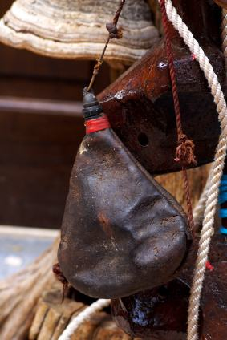

Mark 2:22
And no one pours new wine into old wineskins. Otherwise, the wine will burst the skins, and both the wine and the wineskins will be ruined. No, they pour new wine into new wineskins

Slide 3
Old Wineskin
Symbols
New Wine
New Wineskin

Slide 4
How to be a new wineskin
NEW MINDSET
Who you think you are

Slide 5
How to be a new wineskin
NEW MINDSET
Who you think you are
NEW HABITS
You can't get new results with old behaviors

Slide 6
How to be a new wineskin
NEW MINDSET
Who you think you are
NEW HABITS
FLEXIBILITY
Willingness to expand
You can't get new results with old behaviors

Slide 7
Thank You

